Slide 1

Grade 7 - Mathematics
DBE and textbook

Slide 2
Dear Parents / guardians please see if you can register your children on ixl.com for Mathematics and English for at least a month.
The YouTube channel ‘mathantics’ is one that I also use in the class as it explains work correctly and makes it easy to understand.

Slide 3
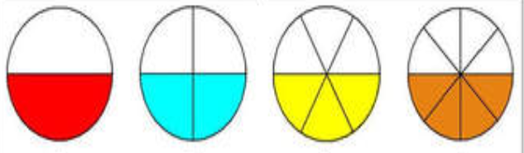

DBE – Fractions (pg. 76)
Equivalent fractions – Equivalent fractions have the same value, even though they may look different. They are fractions that name the same amount or parts.
For example: $\frac{1}{2}$ = $\frac{2}{4}$ = $\frac{3}{6}$ = $\frac{4}{8}$

Slide 4
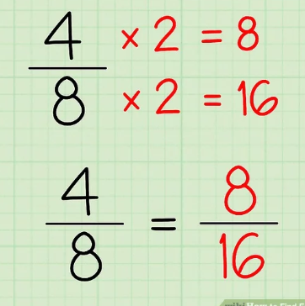
DBE – Fractions (pg. 76)
No 1.
You can write down any equivalent fraction to the given fraction. No drawing needed.
For example

Slide 5
Remember!!
What you do to the top, you do to the bottom, What you do to the numerator, you do to the denominator!
It must be multiplied by the same number or divided by the same number!

Slide 6
No. 2
Write the next or previous equivalent fraction.
Previous – Divide by 2
Next – Multiply by 2
No. 3 – You may leave number 3.

Slide 7
Page 77
No. 4 – No drawing needed.
Remember to carry your whole number and only change the fraction.
Multiply all by 2, 3 and 4.
You will have 3 answers of each question.

