Slide 1
DBE – Lockdown no. 5
You will have to go through the PowerPoint in slide show to understand everything

Slide 2
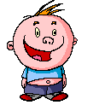
Multiplying
Fractions
Let’s make fractions
our friends!
Now, let’s
not get all crazy
with this “friend” stuff,
Mr. Sunshine.
PowerPoint
Made easy!
© Mike’s Math Mall

Slide 3
Psst…it’s not that kind of introduction, Sparky!
Hi! My
name is Sparky
O’Flannagan!
Oops!
My bad!
Multiplying Fractions
Introduction

Slide 4

Multiplying Fractions
I know you’re not a big fan of fractions, Sparky, but I have some good news when it comes to multiplying them.
What if I told you that when we multiply fractions, we don’t have to worry about making common denominators?
No, sir!
I would call it
super-duper fantabulous,
news!
“Good news”
and “fractions” all in
the same sentence?
Impossible!
I
wouldn’t
call that good news!
Really?
I knew you’d
come around!

Slide 5










Multiplying Fractions 101
When we multiply fractions,
we use the multiplication symbol:
$\frac{1}{3}$
$\frac{2}{5}$
$$×$$
A raised dot:
$\frac{1}{3}$
$$∙$$
$\frac{2}{5}$
$\frac{1}{3}$
$\frac{2}{5}$
Or brackets:

Slide 6



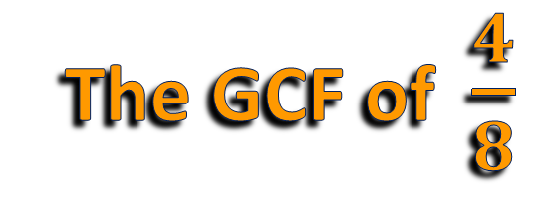
Multiplying Fractions 101
numerator
Simplify – reduce a fraction to its simplest form using the GCF (greatest common factor)
Some terms you need to know:
denominator
$\frac{4}{8}$
$=\frac{1}{2}$
$\frac{÷ 4}{÷ 4}$
Example:
The GCF of $\frac{4}{8}$
is 4.
Use the GCF to
reduce the fraction!

Slide 7


















Multiplying Fractions 101
Mixed Number – a whole number combined with a fraction.
Practice changing improper fractions into mixed numbers.
Improper Fraction – a fraction with a numerator larger than the denominator.
$2\frac{2}{3}$
$$→$$
$$5$$
$$r$$
$$1$$
$\frac{11}{2}$
Write 5 with the remainder 1 over
the denominator 2:
$$→$$
$5\frac{1}{2}$
$$2$$
$$11$$
$$−10$$
$$1$$
Now you try some!
$\frac{5}{3}$
$=1\frac{2}{3}$
$\frac{14}{5}$
$=2\frac{4}{5}$
$\frac{27}{4}$
$=6\frac{3}{4}$
1)
2)
3)

Slide 8

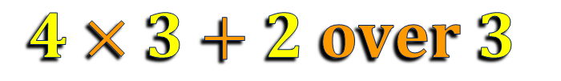





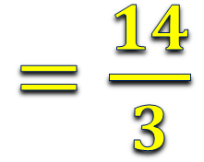

Multiplying Fractions 101
Practice changing mixed numbers into improper fractions.
Take the whole number times the denominator, add the numerator, and place over the denominator.
$4\frac{2}{3}$
$=\frac{14}{3}$
$$4×3+2 over 3$$
Give it a try!
$1\frac{1}{4}$
$=\frac{5}{4}$
$3\frac{3}{5}$
$=\frac{18}{5}$
$6\frac{5}{6}$
$=\frac{41}{6}$
1)
2)
3)

Slide 9
Part 1
Multiplying
Proper Fractions

Slide 10
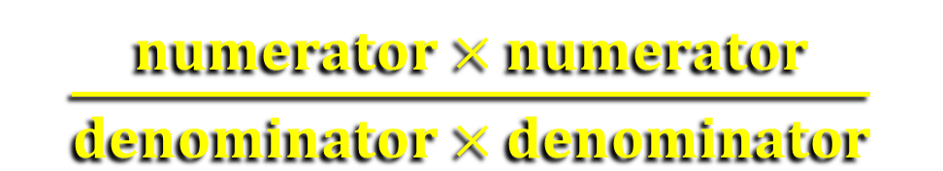
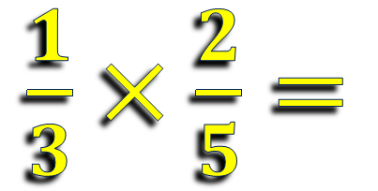
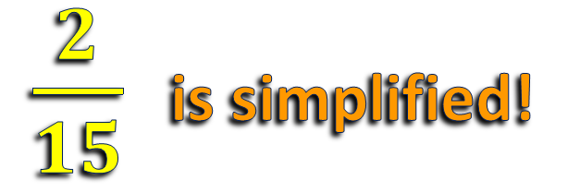


Multiplying Fractions
$\frac{numerator × numerator}{denominator × denominator}$
To multiply fractions:
$\frac{1}{3}×\frac{2}{5}=$
Example 1:
I’m finding
this somewhat
interesting. Continue,
please!
$\frac{1 × 2}{3 × 5}$
$=\frac{2}{15}$
$\frac{2}{15}$ is simplified!
Always check to be sure the product is simplified!

Slide 11









Multiplying Fractions
Example 2:
Example 3:
$\frac{3}{4}×\frac{5}{6}$
$=\frac{3 × 5}{4 × 6}$
$\frac{7}{2}×\frac{3}{5}$
$=\frac{7 × 3}{2 × 5}$
$=\frac{15}{24}$
$\frac{÷ 3}{÷ 3}$
$=\frac{5}{8}$
$=\frac{21}{10 }$
$=2\frac{1}{10}$
Don’t forget to simplify!
Change to a mixed number!

Slide 12











Time to Show Your Stuff!
Multiply the following fractions.
1)
$\frac{1}{4}×\frac{3}{5}$
$=\frac{3}{20}$
2)
$\frac{4}{3}∙\frac{1}{2}$
$=\frac{2}{3}$
3)
$\frac{4}{5}×\frac{3}{4}$
$=\frac{3}{5}$
4)
$=1\frac{4}{5}$
$\frac{6}{5}$
$\frac{3}{2}$

Slide 13



Crafty Cross-Cancelling
Step 2: See if those numbers have a GCF > 1. If so, divide each number by that GCF.
Now, let’s look at a method called cross-cancelling, using a previous problem.
Step 1: Look at the numbers across from each other (diagonal numbers).
1
1
$=\frac{1}{4}$
$\frac{3}{8}∙\frac{2}{3}$
$=\frac{1}{4}∙\frac{1}{1}$
So the
answer is already simplified?
4
1
Sparky
approves but needs to see more!
What’s the GCF of 3 and 3?
3
What’s the GCF of 2 and 8?
2
Yep!

Slide 14
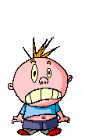



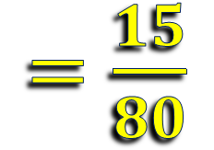




Crafty Cross-Cancelling
Let’s do a side-by-side comparison to see how cross-cancelling makes multiplying fractions easier.
Standard Method:
Cross-cancel method:
$=\frac{5 ∙ 9}{12 ∙ 20}$
1
$\frac{5}{12}×\frac{9}{20}$
3
$\frac{5}{12}×\frac{9}{20}$
$=\frac{1 ∙ 3}{4 ∙ 4}$
4
4
$=\frac{45}{240}$
$=\frac{15}{80}$
It makes
the fraction numbers smaller and helps simplify the answer!
I hate
to admit it, but
this cross-cancelling
thingy is kinda
sweet!
$=\frac{3}{16}$
This is
not going to
go over well with
the ladies!
$=\frac{3}{16}$
You sound like a math teacher, Sparkles!
I agree!

Slide 15
Part 2
Multiplying
Mixed Numbers

Slide 16




Multiplying Mixed Numbers
Before we can multiply mixed numbers, we need to change them into improper fractions.
Example 1:
$1\frac{1}{3}×2\frac{1}{3}$
$= \frac{4}{3}×\frac{7}{3}$
$=\frac{28}{9}$
$= 3\frac{1}{9}$

Slide 17





Multiplying Mixed Numbers
Example 2:
$3\frac{1}{5}∙2\frac{4}{8}$
$= \frac{16}{5}∙\frac{20}{8}$
2
4
1
1
This looks
like it might be a
good time to use some of that fancy cross-
cancelling!
$$=8$$
I’m
not used to
things making sense…Need
air now!
$=\frac{2}{1}∙\frac{4}{1}$
$=\frac{8}{1}$
All this
junk is actually starting to make sense!
I’m really
starting to wig
out here!
But isn’t that a good thing?
What’s wrong, Sparkington?
We better practice!
Great idea, chief!

Slide 18












Show us how it’s Done!
Multiply the following mixed numbers.
$1\frac{2}{3}×2\frac{1}{2}$
$=4\frac{1}{6}$
$=\frac{5}{3}×\frac{5}{2}$
$=\frac{25}{6}$
1)
$2\frac{1}{5}×5$
$$=11$$
$=\frac{11}{5}×\frac{5}{1}$
1
$=\frac{11}{1}$
2)
1
$2\frac{2}{6}×4\frac{1}{2}$
$= \frac{14}{6}×\frac{9}{2}$
3
$=\frac{21}{2}$
$=10\frac{1}{2}$
3)
7
2
1

Slide 19
Multiplying Fractions
So, how did it go with the mixed numbers, Sparky?
Because
I think I actually wanna
start becoming friends with fractions!
Fantastical!
But I’m starting to get a little worried.
Oh, really?
And why’s that?
That’s just weird, Mr. Sunshine!
© Mike’s Math Mall

Slide 20
Do page 82 till 89 in your DBE books

